Slide 1
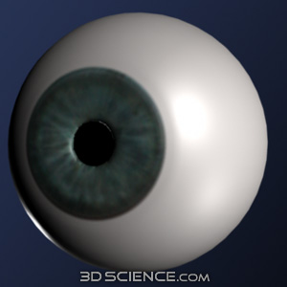
CORNEA AND RETINA
Friends….or Foes….?
DR. AJAY I. DUDANI
M.S.,DNB,FCPS,DOMS,
Vitreoretinal surgery & Laser Specialist,
Consulting eye surgeon
K.J. Somaiya Hospital,
Bombay Hospital.

Slide 2


CORNEA & RETINA
FRIENDS …. OR FOES …..?

Slide 3
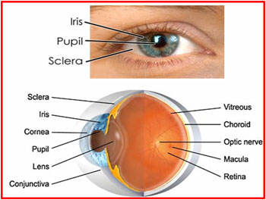
CORNEA & RETINA

Slide 4
ROLE OF NORMAL HEALTHY TRANSPARENT CORNEA
Clear visualisation of retina; normal or diseased ( DO, I/O, Slit lamp Biomicroscopy)
Investigations for diagnosis of retinal conditions ( FFA, ERG)
Diagnosing complications of retinal conditions; neovascular glaucoma ( Gonioscopy)
Easy & adequate treatment of retinal disorders (Laser or even Vitreoretinal Surgeries)

Slide 5
CONDITIONS AFFECTING CORNEA & RETINA ( INDEPENDENT OF EACH OTHER)
Congenital anomalies –
Micro or megalocornea ; medullated nerve fibres in retina
Degenerations or Dystrophies –
Lattice or Granular corneal dystrophies or Spheroidal degenerations ; Retinitis Pigmentosa or ARMD

Slide 6
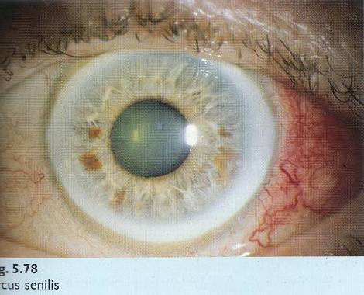
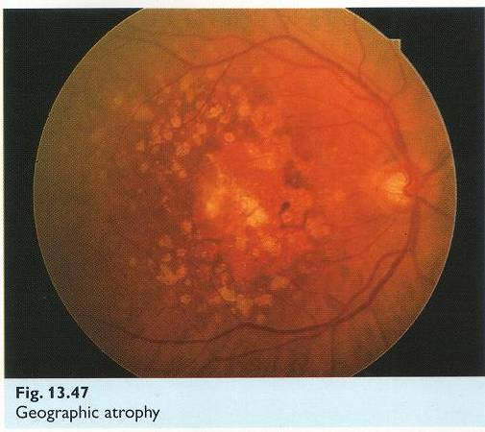
CORNEAL & RETINAL CONDITIONS LINKED BY VARIOUS FACTORS
Age
ARCUS SENILIS
AGE RELATED MACULAR DEGENERATION

Slide 7
CONGENITAL
Congenital syphilis –
-Interstitial keratitis
-Chorioretinitis
Congenital rubella syndrome –
-microcornea, corneal clouding
-rubella keratitis resembling CHED (congenital-
hereditary endothelial dysfunction)
-speckled retinitis of posterior pole

Slide 8
INFECTIONS
HIV
Syphilis ( interstitial keratitis & salt pepper fundus)
Lyme disease ( bilateral keratitis, papillodema, retinal haemorrhages, exudative RD’s, panophthalmitis)
Infectious mononucleosis ( nummular keratitis, retinal periphlebitis)
Onchocerciasis (superficial & deep keratitis, chorioretinitis)

Slide 9
SYSTEMIC INFECTIONS AFFECTING BOTH CORNEA & RETINA
Acquired immunodeficiency syndrome
CORNEA
-Herpes zoster keratitis
-Herpes simplex keratitis
-Keratoconjunctivitis sicca
RETINA
-CMV retinitis
VZV- PORN
-(progressive outer retinal necrosis)
-Toxoplasmosis

Slide 10
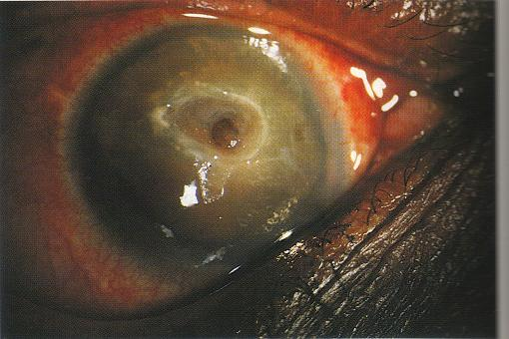
HERPETIC STROMAL NECROTIC KERATITIS
CORNEAL PERFORATION

Slide 11
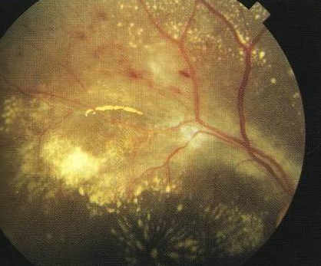
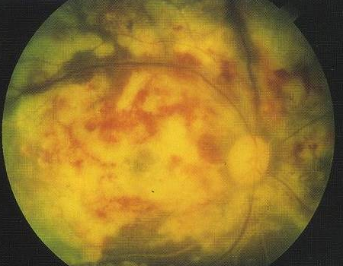
CMV RETINITIS
END STAGE

Slide 12
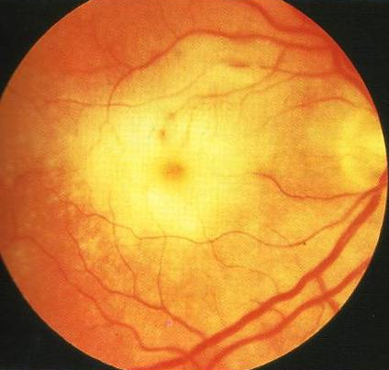
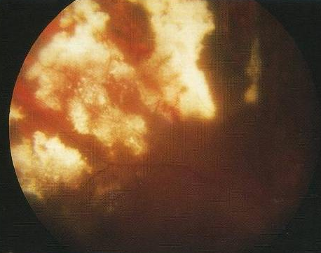
VZV RETINITIS
PORN
ADVANCED RETINAL NECROSIS

Slide 13
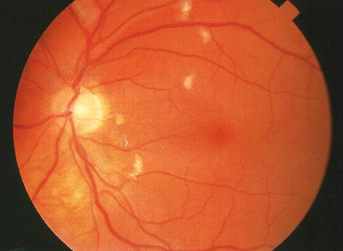
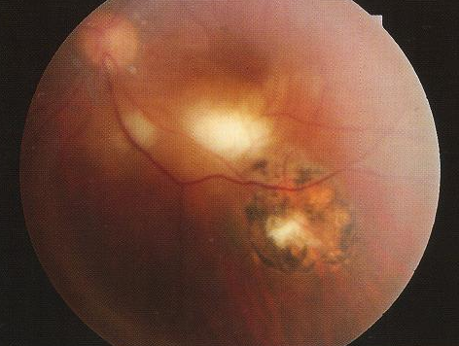
COTTONWOOL SPOTS IN HIV RETINOPATHY
TOXOPLASMA RETINITIS

Slide 14
COLLAGEN DISEASES
Commonly associated with keratitis (peripheral ulcerative) , keratoconjunctivitis sicca (dry eye syndromes)& retinal odema, vascular changes, hemorrhages…
Periarteritis nodosa
Scleroderma
Systemic lupus erythematosus
Wegeners granulomatosis
Chronic granulomatous disease (sarcoidosis) associated with KCS & Fundal Granulomas

Slide 15
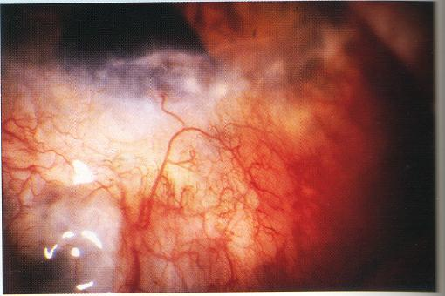
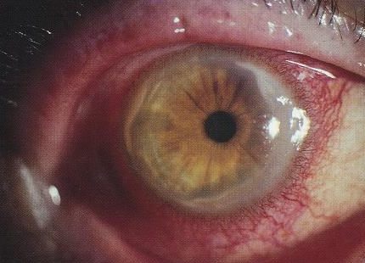
ULCERATIVE KERATITIS IN RHEUMATOID ARTHRITIS
SCLEROSING KERATITIS
PERIPHERAL CORNEAL MELTING
Pts on long term treatment may also have chloroquine maculopathy

Slide 16
CARDIOVASCULAR DISEASES
Arcus senilis
Lipid keratopathy
Retinal odema, haemorrhages, hard exudates
Vessel tortuosity, copper silver wire vascular changes
Papilledema
Star maculopathy

Slide 17
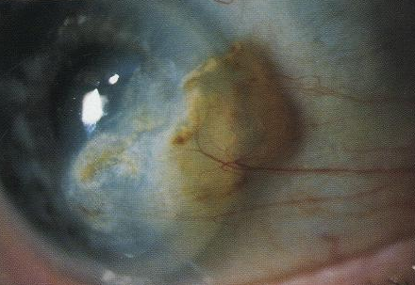
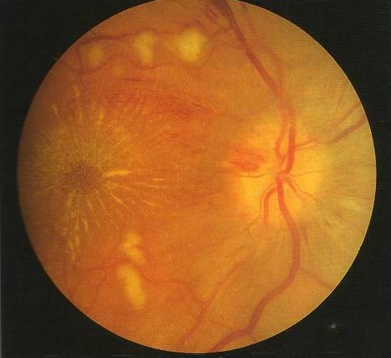
LIPID KERATOPATHY
SEVERE HYPERTENSIVE RETINOPATHY

Slide 18
Occlusive vascular diseases
Central retinal vein occlusion
Rubeosis iridis
Neovascular glaucoma
Corneal edema

Slide 19
ENDOCRINE DISEASES
DIABETES MELLITIS
Diabetic retinopathy
Rubeosis iridis , Corneal odema
Corneal recurrent erosions
HYPERTHYROIDISM
Exposure keratitis
Papillodema
CUSHINGS DISEASE (HYPERADRENALISM)
Exophthalmos – Exposure keratitis
Hypertensive retinopathy

Slide 20
NUTRITIONAL DISORDERS
VITAMIN A DEFICIENCY
Keratomalacia
Degeneration of rod outer segments
HYPERVITAMINOSIS
Raised intracranial pressure- Papillodema (A)
Cystoid macular odema (B)
Calcium deposits in cornea (D)

Slide 21
METABOLIC DISEASES
AMYLOIDOSIS
Amyloid nodules in corneal stroma
Vitreous opacities, retinal haemorrhages
CYSTINOSIS
Corneal crystals in anterior stroma
Retinal peripheral pigment clumping
FABRY’S DISEASE
Vortex pattern corneal epithelial opacities
Retinal haemorrhages, macular edema
LIPIDOSIS
Lipid keratopathy
Lipaemia retinalis

Slide 22
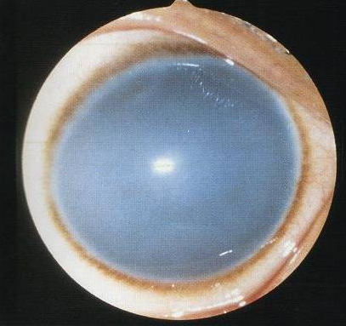
Pigmentary retinopathy occurs in all Mucopoly-Saccharidoses except Morquio & Maroteaux Lamy
CORNEAL CLOUDING IN HURLER SYNDROME
(in all MPS except Hunter &
Sanfilippo)

Slide 23
CORNEAL SURGERIES AFFECTING RETINA
Refractive corneal surgeries ( leading to RRD, endophthalmitis)
Penetrating keratoplasty ( leading to endophthamitis, RD)

Slide 24
RRD FOLLOWING LASIK
Is infrequent
A study reported 0.05% incidence at mean of 24 mths after lasik
Occurred 1 – 36 mths (mean 12.6 mths) after lasik
Occurred in eyes with mean -6.96 D of myopia before lasik

Slide 25
If managed promptly, can result in good vision
No cause effect relationship between lasik & RRD was proven
However it is recommended that all pts scheduled for lasik undergo a thorough dilated fundus examination with scleral depression & also treatment of retinal lesions predisposing to RRD before the refractive surgery

Slide 26
ENDOPHTHALMITIS
FOLLOWING LASIK
Incidence of sight threatening complications after lasik still remains low.
Reports of endophthalmitis after incisional refractive surgeries – RK, hexagonal keratotomy, Ruiz procedure exist

Slide 27
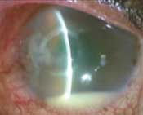
Endophthalmitis following Lasik

Slide 28
Causes
Corneal stroma may come in contact with infectious agents from
Patients own body
Contaminants present on instruments
Surgeon or operating room
Breaks in epithelial barrier & excessive surgical manipulation
Post op delayed epithelialisation of cornea, topical steroids, therapeutic CL’s, decreased corneal sensitivity & dry eye state

Slide 29
ENDOPHTHALMITIS AFTER PKP
Reported incidence of 0.2%, has decreased in the last decade
Infections developed within 72 hrs & in majority the donor rim culture grew the same organism as was obtained from the AC or vitreous
Both bacterial & fungal
Fungal enophthalmitis transmitted by K-sol stored corneas
Torulopsis glabrata endophthalmitis after keratoplasty with organ cultured corneas

Slide 30
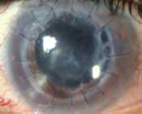
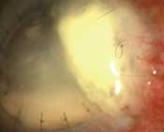
Endophthalmitis after PKP

Slide 31
RD FOLLOWING KERATOPLASTY FOR ANTERIOR SEGMENT TRAUMA
20 keratoplasties with or without anterior segment reconstruction carried out showed 80% clear grafts
Complications –
RD 2 cases
graft rejection 2 cases
glaucoma 2 cases
amblyopia 1 case
retinal folds 1 case

Slide 32
RETNAL SURGERIES AFFECTING CORNEA
Retinal Detachment Surgeries
Vitreoretinal surgeries (VRS)

Slide 33
CORNEAL ODEMA FROM IOP RISE AFTER RD SURGERY
Scleral buckling procedures alter anatomical configuration of globe & affect rise in IOP
Factors affecting IOP include
Degree of shortening of encirclage
if SRF drainage done (2-3 mm)
if SRF drainage not done (3-6mm)
Tightness with which scleral fixation sutures are tied (1 tight suture raises IOP by 10mmHg immediately)

Slide 34
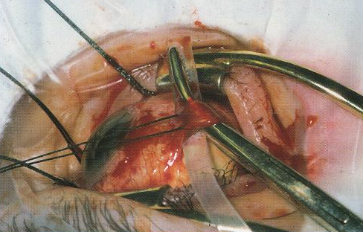
SCLERAL BUCKLING SURGERY
FOR RD

Slide 35
CORNEAL ODEMA FROM GLAUCOMA AFTER VRS
Erythroclastic glaucoma – secondary to inadequate removal of intraocular haemorrhage
Inflammatory glaucoma – trabeculitis
Expanding gas bubble – mixing error (confusing cubic cm in syringe for %, pupillary block or unwise decision to use expanding gas in a total fill surgical situation)

Slide 36
Emulsification glaucoma – uncommon delayed complication of silicone oil use
Steroid glaucoma
Hyperoxygenation of vitreous cavity & secondarily acqueous humour occur after vitrectomy which is responsible for trabecular damage (Sanley Chang)

Slide 37
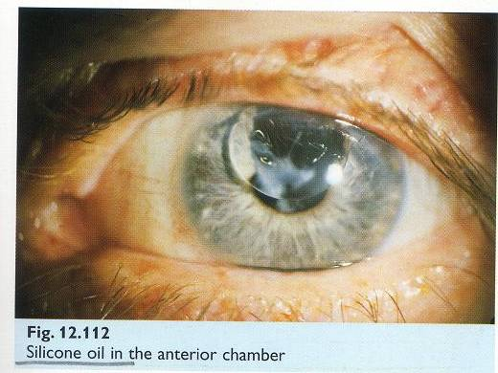
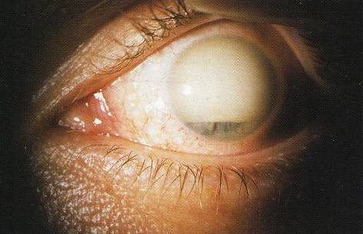
SILICON OIL IN AC
EMULSIFIED SILICON OIL IN AC

Slide 38
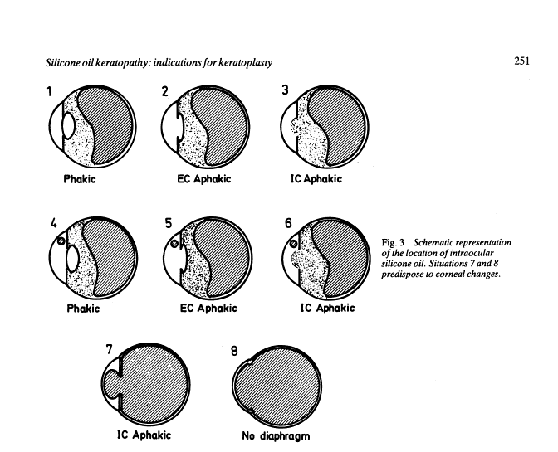
SILICONE OIL KERATOPATHY

Slide 39
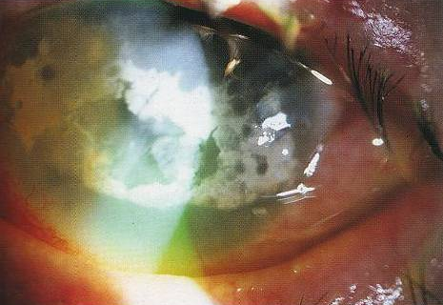
EPITHELIAL BREAKDOWN IN LONG
STANDING BAND KERATOPATHY

Slide 40
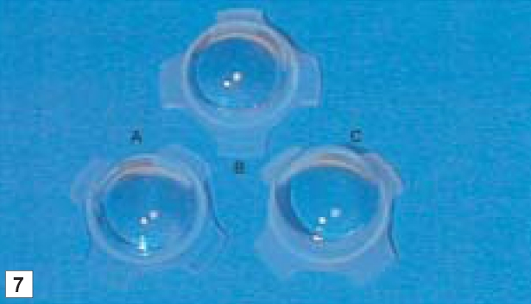
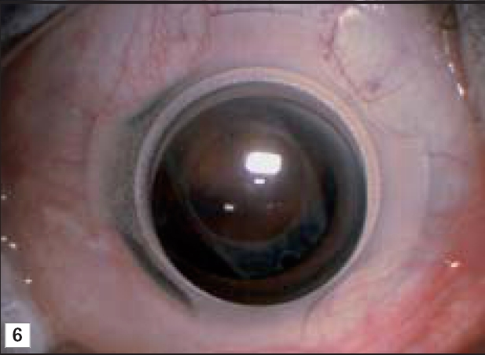
VITREO- RETINAL SURGERIES
Self retaining corneal contact lens system

Slide 41
CORNEAL CONTACT LENS SYSTEM FOR VITREOUS SURGERY
They neutralise the refractive power of cornea
They afford excellent visualisation of fundus, vitreoretinal pathologies
Allow corneal contact on rotation of globe & eliminate accumulation of blood or bubbles between lens & cornea

Slide 42
CORNEAL OPACITIES – HINDRANCE IN RETINAL SURGERIES
Cornea may become cloudy,
opacified due to injury,
infection or
scar tissue
Scar tissue prevents light from passing through cornea resulting not only in vision loss but also in difficult visualisation &
treatment of retinal
(or other posterior segment) lesions.

Slide 43
Epithelial scrapping done to improve visualisation
Use of new ophthalmic microendoscopes
Endoscopic laser photocoagulation of ischaemic retina against opacity of anterior eye
Use of temporary keratoprosthesis followed later by keratolpasty

Slide 44
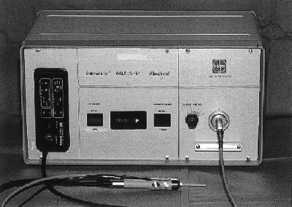
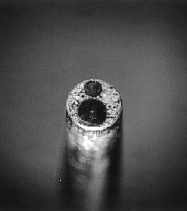
MICROENDOSCPE

Slide 45
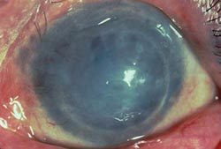
KERATOPROSTHESIS
Penetrating keratoplasty combined with vitrectomy using a temporary keratoprosthesis is a safe & effective method in treating severe ocular injury with blood stained cornea (or opacified corneas) & no light perception

Slide 46
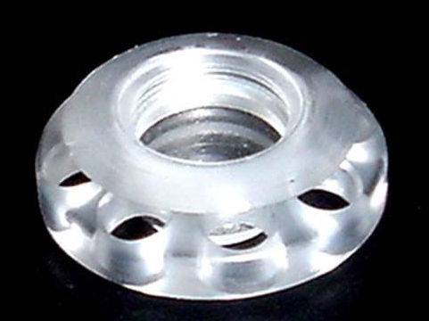
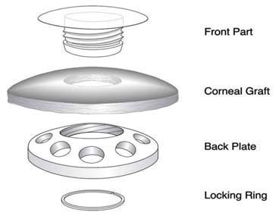
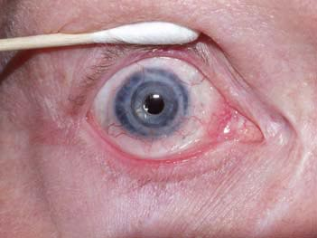
KERATOPROSTHESIS

Slide 47
LASIK AFTER RD SURGERY
Myopic refractive errors are common in eyes that develop RD
Myopic changes may also be induced by RD surgeries because of changes in axial length, anterior chamber depth or position of the lens
A study has shown improvement in UCVA in all eyes & no decline in BCVA in any of them
No retinal complication in post-op period although F/U is required
Only problem found was that of extensive conjunctival scarring which hampers the function of suction ring of microkeratome

Slide 48
OCULAR TRAUMA
Blunt
Penetrating
Intraocular foreign bodies
Sympathetic ophthalmitis
Radiation

Slide 49
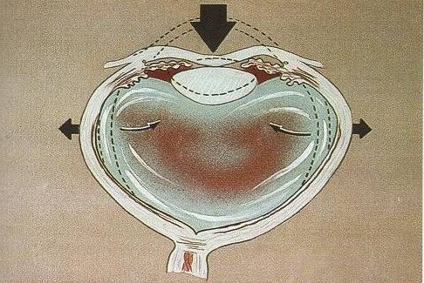
MECHANISM OF BLUNT TRAUMA

Slide 50
Corneal abrasion – which stains with fluorescein
Acute corneal edema – due to focal or diffuse dysfunction of corneal endothelium
may be associated with folds in descemet membrane.
Commotio retinae – gives grey appearance to fundus, frequently temporal occasionally may involve macula causing cherry red spot at fovea.
Subsequent progressive pigmentary degeneration & macular hole formation may occur.
Retinal breaks leading to RD may occur in the form of retinal dialysis, equatorial tears or macular holes.

Slide 51
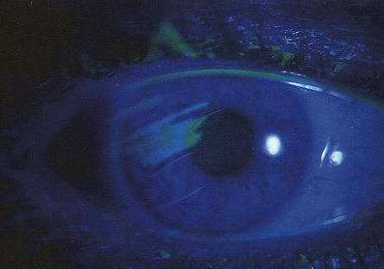
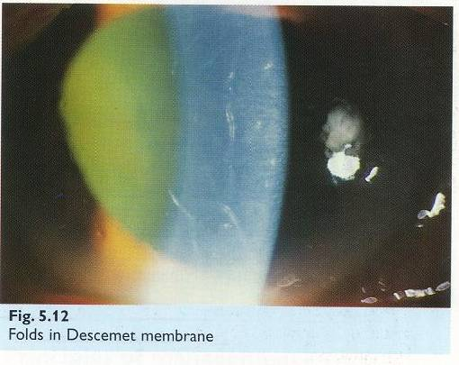
CORNEAL ABRASION
DESCEMETS FOLDS

Slide 52
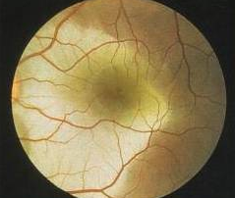
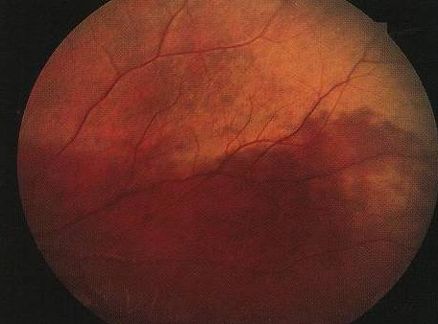
Commotio retinae
INVOLVING MACULA
INVOLVING PERIPHERY

Slide 53
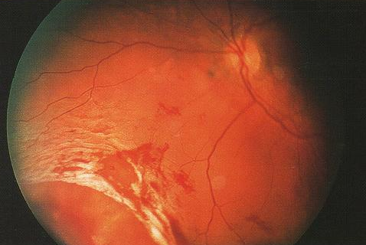
TRAUMATIC RETINAL DIALYSIS

Slide 54
PENETRATING OCULAR TRAUMA
Assault, domestic accidents, sports injuries may cause corneal lacerations with or without iris prolapse.
Tractional RD may occur secondary to vitreous incarceration in the wound & intragel vitreous haemorrhage which stimulates fibroplastic proliferation. Subsequent contraction of membranes leads to tractional RD.

Slide 55
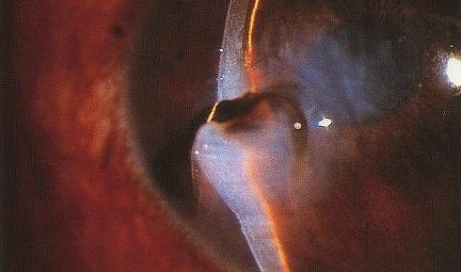
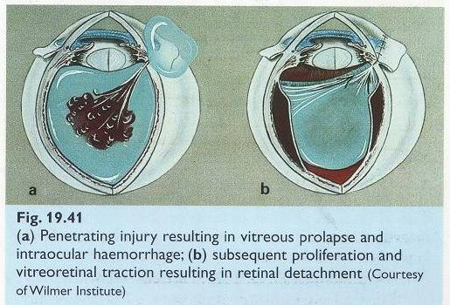
PENETRATING INJURY
CORNEAL WOUND WITH IRIS PROLAPSE
VITREOUS PROLAPSE , INTRAOCULAR HAEMMORHAGE, TRD

Slide 56
INTRAOCULAR FOREIGN BODIES
May traumatize the eye mechanically
Introduce infection – endophthalmitis or panophthalmitis
Exert other toxic effects on intraocular structures depending on their type
stone, organic FB’s – infection
iron, copper - sideosis, chalcosis respectively
glass, plastics, gold, silver - inert

Slide 57
CHALCOSIS
High copper content in FB – violent endophthalmitis like picture
Low copper content – chalcosis, picture similar to wilsons disease with Kayser Fleischer Ring in cornea & sunflower cataract.
Retinal deposition results in golden plaques visible ophthalmoscopically.

Slide 58
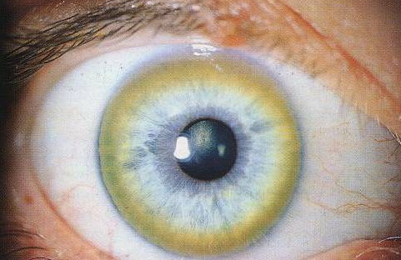
KAYSER - FLEISCHER RING

Slide 59
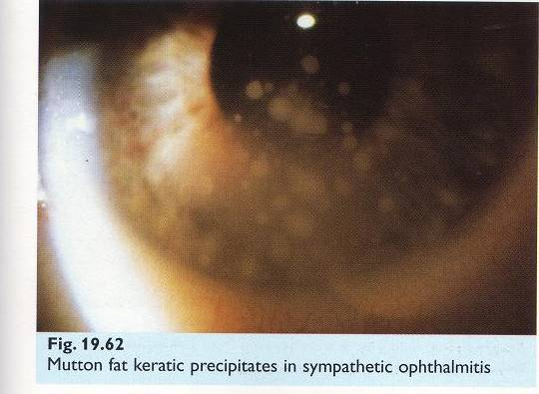
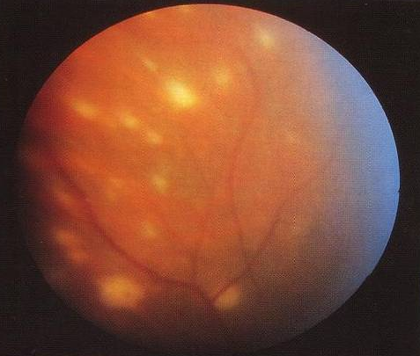
SYMPATHETIC OPHTHALMITIS
Mutton fat keratic precipitates and multifocal choroiditis.

Slide 60
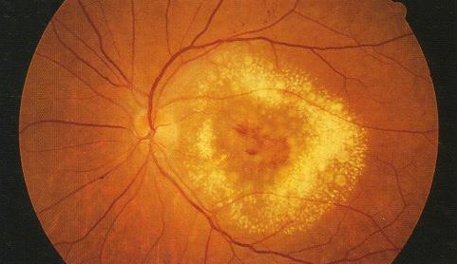
RADIATION RETINOPATHY
Trophic changes in eye can also occur after radiotherapy in the form of corneal epithelial breakdown.

Slide 61
DRUGS AFFECTING CORNEA & RETINA
Chloroquine & hydroxychloroquine
Vortex keratopathy – whorl like fine greyish to golden brown corneal epithelial deposits in form of arborizing horizontal lines resembling cats whiskers.
Unlike retinopathy, it bears no relationship to dosage, duration or treatment.

Slide 62
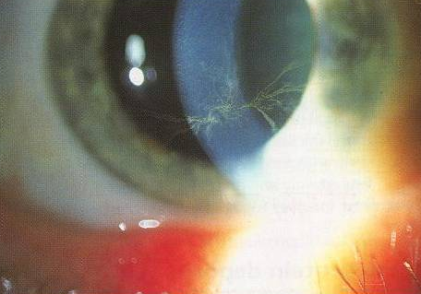
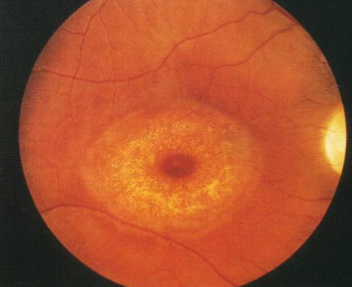
VORTEX KERATOPATHY
SEVERE CHLOROQUINE MACULOPATHY

Slide 63
CHLOROQUINE MACULOPATHY
Risk increases when cumulative dose exceeds 300g.(250 mg daily for 3 yrs)
Loss of foveal reflex
Central foveal pigmentation surrounded by depigmented zone of RPE atrophy which is again surrounded by hyperpigmented ring
Bull’s eye macular lesion
Unmasking of larger choroidal blood vessels & development of pigment clumps in retinal periphery.

Slide 64
Tamoxifen crystalline maculopathy & vortex keratopathy
Specific anti estrogen used in treatment of selected patients with breast carcinoma
Multiple yellow crystalline ring like deposits at the maculae
Persist on cessation of treatment
Maculopathy rare, routine screening not warranted

Slide 65
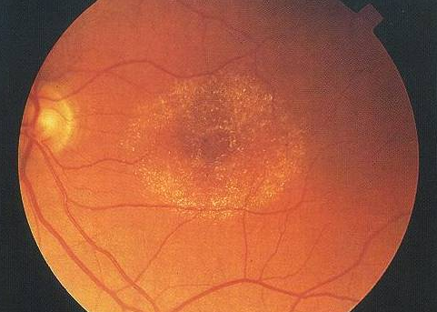
TAMOXIFEN CRYSTALLINE MACULOPATHY

Slide 66
SYNDROMES AFFECTING CORNEA & RETINA
Ehlers danlos syndrome type 6
Alports syndrome
Marfans syndrome
Other ocular associations include:
Keratoconus associated with retinitis pigmentosa & ROP

Slide 67
EHLER DANLOS SYNDROME
TYPE 6 connective tissue disorder involving genetically determined abnormalities of collagen
CORNEA
-Microcornea
-Keratoconus
-Cornea plana
-High myopia
RETINA
-Retinal detachment
-Angiod streaks

Slide 68
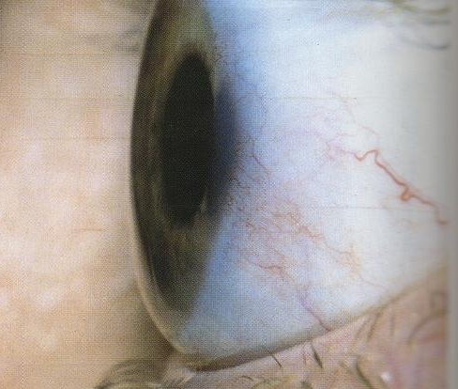
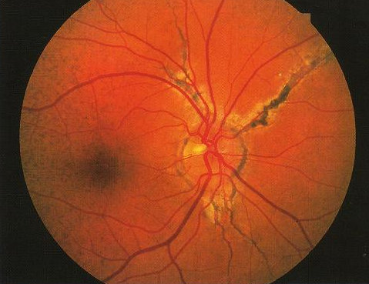
Ocular sclerotic
Ehler Danlos Syndrome Type 6
ADVANCED ANGIOD STREAKS
CORNEA PLANA

Slide 69
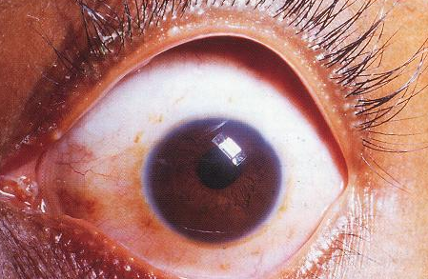
MICROCORNEA

Slide 70
ALPORTS SYNDROME
Rare abnormality of glomerular basement membrane caused by mutations in genes encoding particular forms of type 4 collagen
Yellow punctate flecks in premacular area sparing fovea
Larger flecks become confluent in periphery
Associated with anterior lenticonus & occasionally posterior polymorphous corneal dystrophy

Slide 71


ALPORTS SYNDROME
POSTERIOR POLYMORPHOUS DYSTROPHY
PERIPHERAL FLECKS IN RETINA

Slide 72
KERATOCONUS WITH RETINITIS PIGMENTOSA
Non-infective,progressive, bilateral thinning of cornea with ectasia of conical shape
Direct ophthalmoscopy from a distance of 1 foot shows an oil droplet reflex
Retinoscopy shows an irregular scissor reflex
Slit lamp biomicroscopy shows very fine vertical deep stromal striae (vogt lines) which disappear with external pressure on the globe

Slide 73


KERATOCONUS
RETINITIS PIGMENTOSA

Slide 74


OIL DROPLET REFLEX IN KERATOCONUS
ACUTE HYDROPS IN KERATOCONUS

Slide 75

THUS,
NO PART OF THE HUMAN EYE CAN BE
STUDIED IN ISOLATION
THE CORNEA & RETINA INFLUENCE
EACH OTHER IN HEALTH , FUNCTION &
DISEASE
THE INFLUENCE OF ONE ON THE
OTHER IS OF CLINICAL SIGNIFICANCE
TO THE PRACTISING CLINICIAN

Slide 76

THANK YOU

